Slide 1





GitHub Copilot Hackathon
Weather Forecasting Tool (Python)

Slide 2
404
NameNotFound
TEAM NAME:
CONTRIBUTORS:
Chandni Beniwal (Leader)
Dinesh Brahmadandi

Slide 3
Project Summary
Problem Statement:
Create a command-line tool that accepts a city's name and returns the current weather forecast. Leverage OpenWeatherMap API to fetch weather data and parse it using Python. Your solution should demonstrate how GitHub Copilot can help you with API usage, data parsing, and error handling.
Solution:
We have designed a solution to create a Python command-line tool that utilizes the OpenWeatherMap API for fetching the current weather forecast of a specified city. Leveraging the capabilities of GitHub Copilot, the tool efficiently handles API usage, data parsing, and error handling. Users can input the name of a city, triggering an API request to retrieve the relevant weather data. The response is then parsed to extract the necessary information, which is finally displayed as the forecast to the user. Our solution ensures seamless handling of any potential errors that may occur during the API request or data parsing process, guaranteeing a reliable and user-friendly experience.

Slide 4
Business Use-cases
The business use case of the problem statement could be to provide a weather forecast service to users or integrate weather data into other applications. Here are a few potential business use cases:
Travel and Tourism: Provide real-time weather information to travelers and help them make informed decisions.
Outdoor Events and Activities: Event organizers could use the tool to check the weather forecast before planning events/activities.
Retail and E-commerce: Online retailers could use this information to personalize product recommendations based on the weather.
Logistics and Transportation: Logistics companies or transportation services could integrate the tool into their systems to optimize operations based on weather conditions.
Agricultural Planning: Farmers or agricultural organizations could utilize to optimize agricultural operations and increase crop yield.

Slide 5

Solution Architecture
City Name
Python CMD Tool (GUI created additionally)
Python Backend (Created with Copilot Assistance)
Request
Weather Details
Response
User
OpenWeatherMap API

Slide 6
Usage of Github Copilot
API Usage
Data Parsing
Error Handling
Copilot can help suggest code snippets by:
Completing API calls based on the OpenWeatherMap API documentation.
Generating the necessary HTTP requests, including headers, query parameters, and API endpoints
Copilot can help suggest code snippets by:
Assists with the parsing of JSON response returned by the OpenWeatherMap API.
Extracting specific data points such as temperature, humidity, wind speed, and weather conditions from JSON response.
Copilot can help suggest code snippets by:
Providing suggestions for implementing error handling mechanisms when interacting with the API.
Handling exceptions, checking for response errors or unexpected data.

Slide 7
Technologies Used
Python libraries import requests import json import tkinter
Github Copilot
OpenWeatherAPI
IDE - VSCode
VCS - Github

Slide 8
Source Code Link:
https://github.com/CB-05/Github-Copilot-Hackathon-

Slide 9
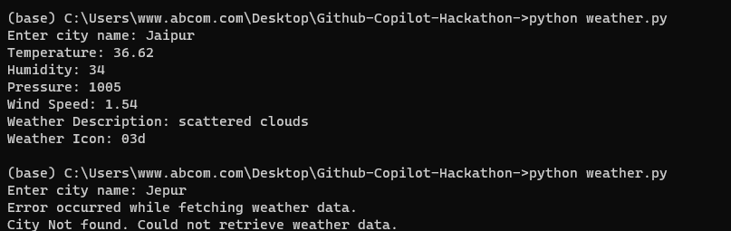
Implementation/Demo
Both success and Failure cases can be seen below.

Slide 10
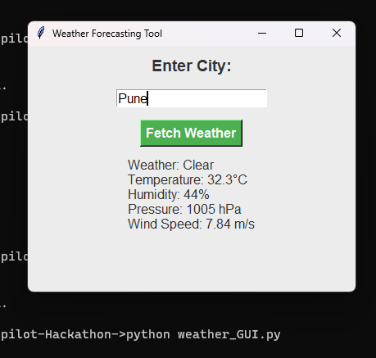
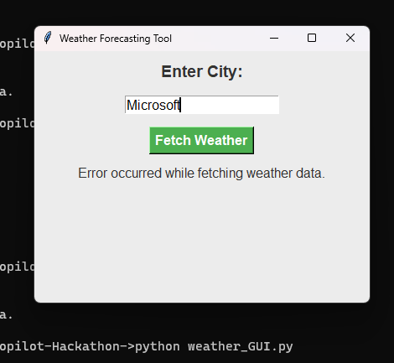
Implementation/Demo
Demo of the GUI created additionally.

